Slide 1
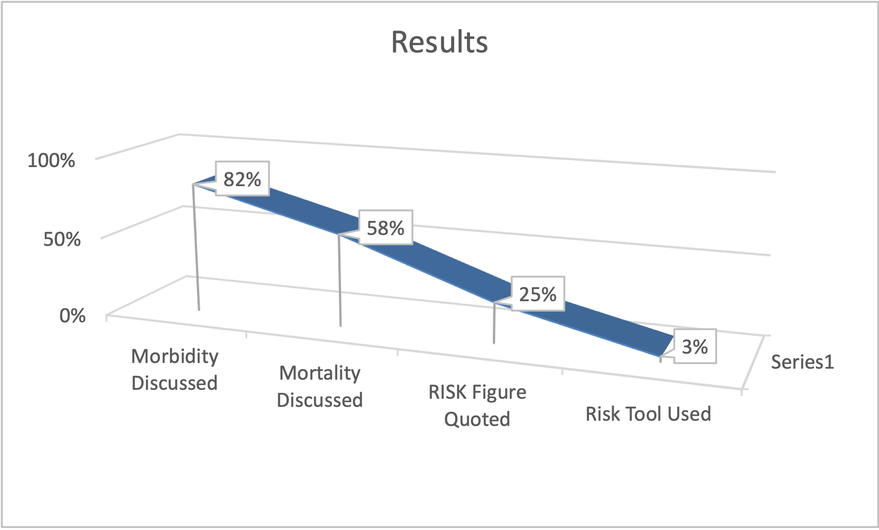
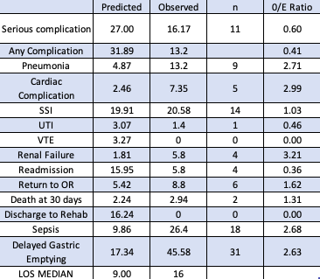
Improving risk prediction in the preoperative clinic by adoption of validated risk tools
V Gongireddy ST6. K Inkpin Consultant.
Department of Anaesthesia, Queen’s Medical Centre, Nottingham.
Introduction
Baseline Audit – Identifying the need for improvement
Evaluation of Risk tools in our patient subset
Implementation of change
Perioperative clinicians ought to discuss morbidity and mortality with individuals presenting for major surgery.
NICE recommends the use of a validated risk stratification tool to supplement clinical assessment when planning surgery. ¹
Perioperative clinic letters of all patients evaluated for major HPB surgery in 2020 were reviewed.
Less than 3% patients had a documented use of a risk validation tool.
Retrospective audit of all patients who underwent Whipples procedure at our center in 2018 and 2109.
Total of 68 patient case notes reviewed and their predicted NSQIP score calculated, as well as the observed complication rate. ²
Increasing awareness amongst perioperative clinicians about risk scoring tools.
Introduction of Desktop shortcuts to NSQIP and SORT calculators in the preoperative clinic.
Introduction of Risk score column on the preanesthetic chart.
Objectives
Way forward
Reaudit our practice
Evaluate practice in other sub specialities like colorectal surgery
Improve quality of risk prediction and documentation by encouraging the use of validated risk prediction tools in preoperative clinic for HPB surgery. Ultimately, this would lead to better patient education, understanding and subsequent informed consent.
Staff Questionnaire – Assessing the appetite for change
Online survey of anesthetists in preoperative clinic and HPB surgeons, using Microsoft Forms.
Responses from 30 anesthetist and 4 HPB surgeons.
66% were aware of the new NICE guidance.
85% of respondents quote a procedure specific risk as part of consultation.
74% use a risk tool to quantify risk.
All the respondents would like to adopt a validated risk tool as part of the preoperative consultation.
SORT and PPOSUM scores the most popular choices.
Materials and Methods
Current practice was audited.
Clinician understanding and opinion was assessed by means of an electronic survey.
Local data was compared to predicted outcomes based on a range of risk assessment tools.
Identify a risk prediction tool which had outcomes similar to observed outcomes.
Educate and implement a validated risk prediction tool.
Evaluate.
References
NSQIP was able to predict the Mortality with an Observed / Expected ratio of 1.31
However, it underpredicted the risk of morbidity due to pneumonia, cardiac complications, sepsis and complications specific to the surgery like delayed gastric emptying.
Median length of stay was also significantly higher than the NSQIP predicted.
Surgical Outcome Risk Tool V2 provided a risk score of 0.79 % for the same patient subset, which is lower than than the 2.94% observed.³
1.https://www.nice.org.uk/guidance/ng180/chapter/Recommendations#preoperative-care
2. https://riskcalculator.facs.org/RiskCalculator
3. http://www.sortsurgery.com
Acknowledgements
No funding received from any sources
Clinical Effectiveness team, Nottingham University Hospitals Project #21-290C.

